Slide 1
Story Board
Zainab dia
Mohammad iskandarani

Slide 2
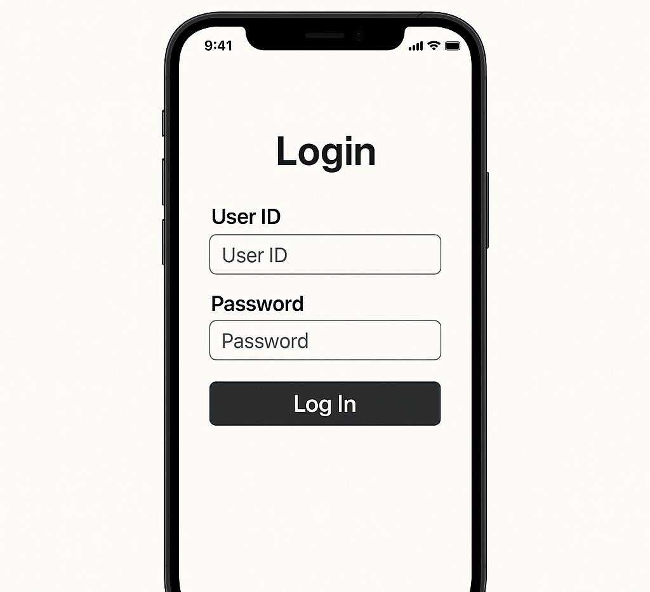
Log In Page

Slide 3
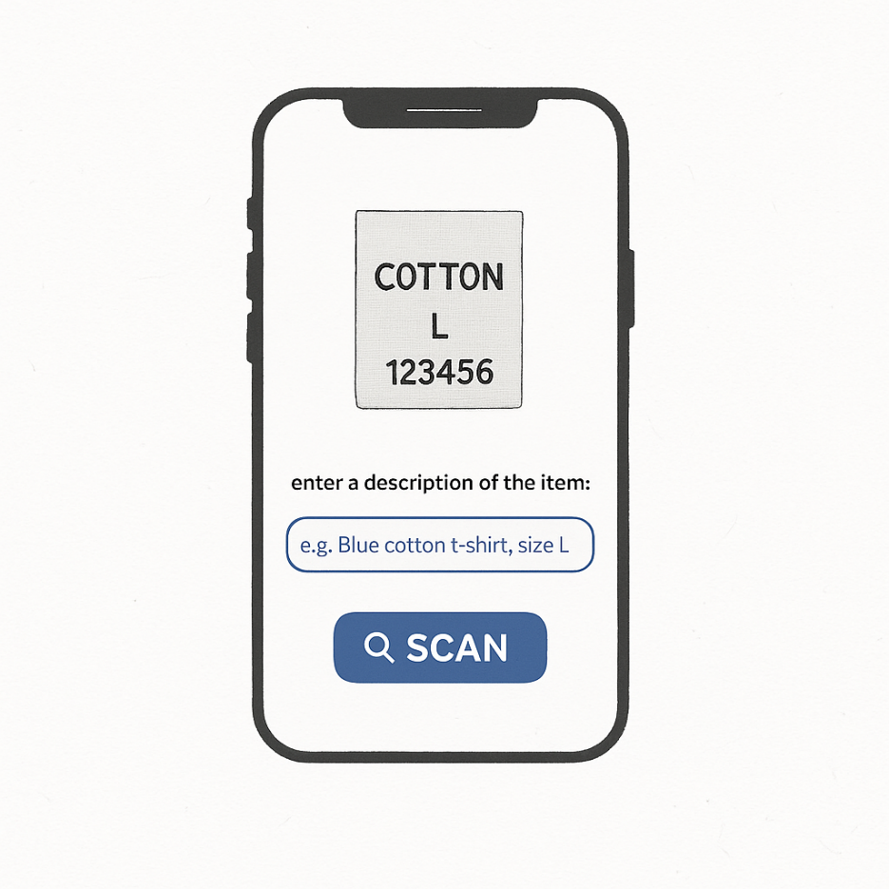
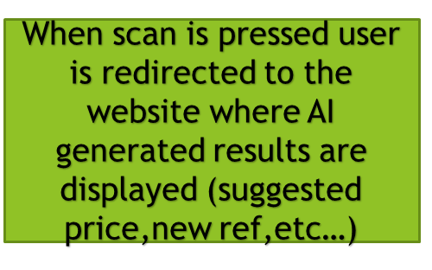
The Mobile App OCR
User captures the tag
User can add any important detail that might not be mentioned on the tag(material,color,etc…)

Slide 4
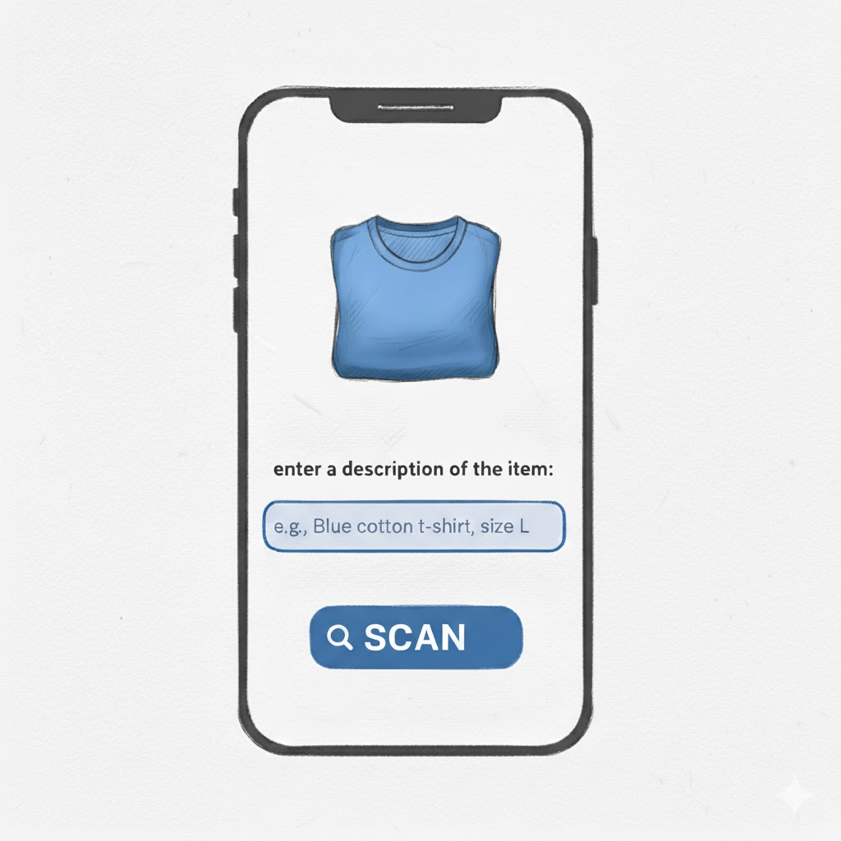
The Mobile App fallback
User captures the item
User can write a manual description to add any details that might be missed by the AI recognition
When scan is pressed user is redirected to the website where AI generated results are displayed (suggested price,new ref,etc…)

Slide 5
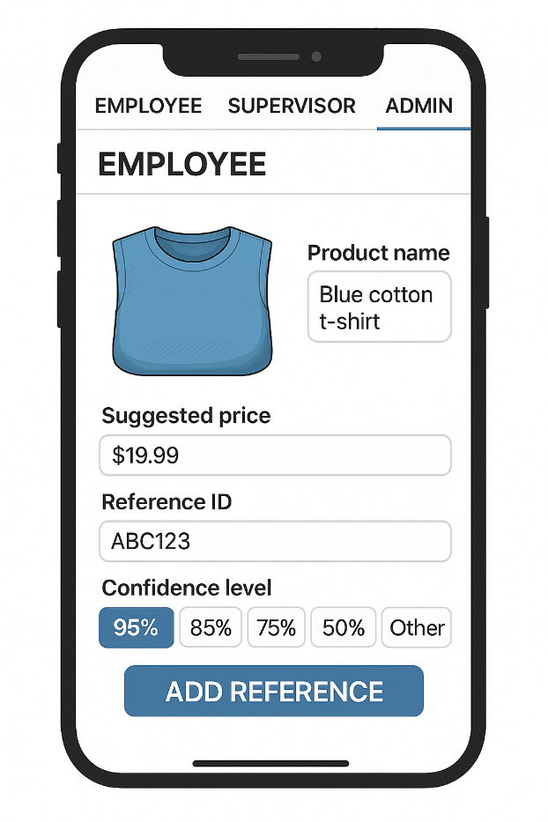
The Website Employees Page
The AI suggests a price by comparing the item with similar products in the database
An image of the item/tag scanned is displayed along with a generated name for it
A unique reference is generated for the item
When the Employee clicks “Add Reference”, the item does not immediately go into the database, instead it gets sent to the Supervisor for approval (to maintain data integrity)
The AIs confidence score shows how certain the system is about its suggestion
And the user can pick any of the levels

Slide 6
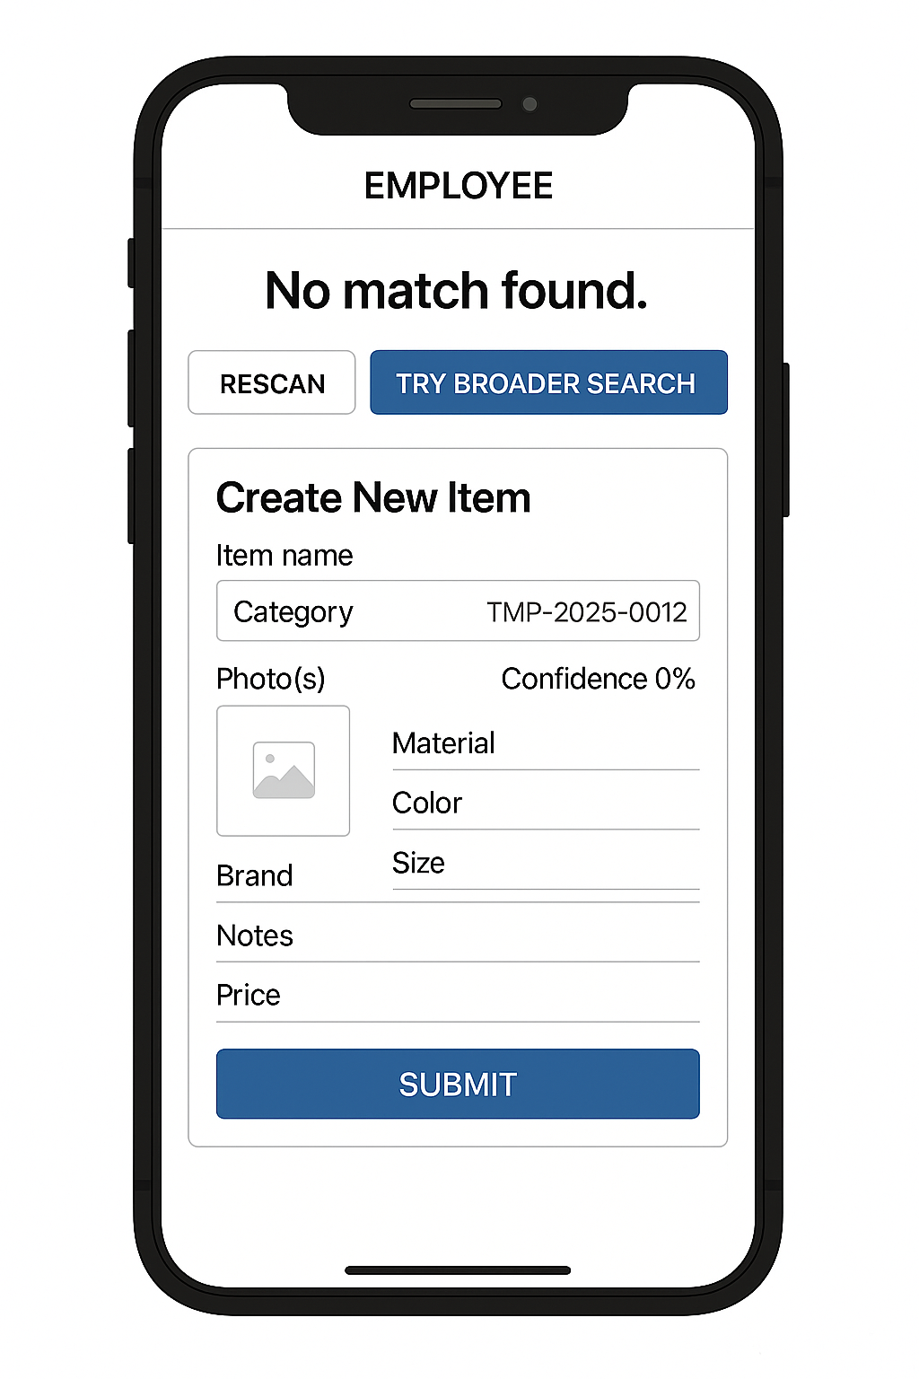
Item Not Found
User has the option to rescan the item or do a broader search
User can create a new item and manually enter the info
Submit the info in which the supervisor can either approve/reject or edit

Slide 7
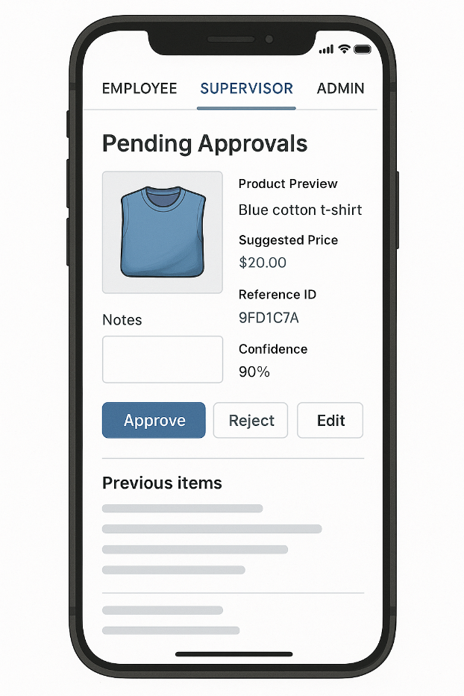
The Website Supervisors Page
Product details (image, name, price, reference ID, and confidence score) are displayed for review
Supervisors can add notes if they believe changes or clarifications are needed
The “Approve” button confirms the AI’s suggestion and adds the item into the database.
The “Reject” button removes the suggestion so it does not enter the database.
The “Edit” option allows supervisors to modify product details before approval
A history of past approvals/rejections can be viewed, giving supervisors context and helping them maintain consistency

Slide 8
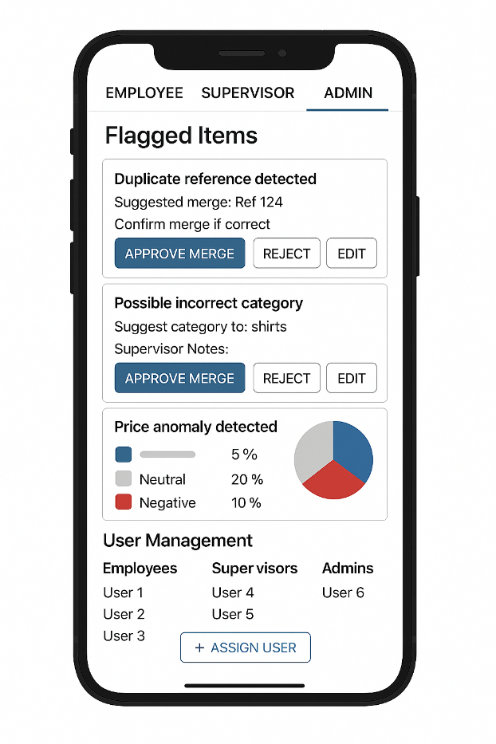
The Website Admins Page
Shows errors automatically detected by the system. Some items include supervisor notes to provide context or corrections.
Admin can Approve Merge, Reject, or Edit the system’s suggestion.
Summarizes customer feedback using NLP analysis, showing the percentage of positive, neutral, and negative responses
displays repeated mistakes and error statistics
Admin can assign roles to users

Slide 9
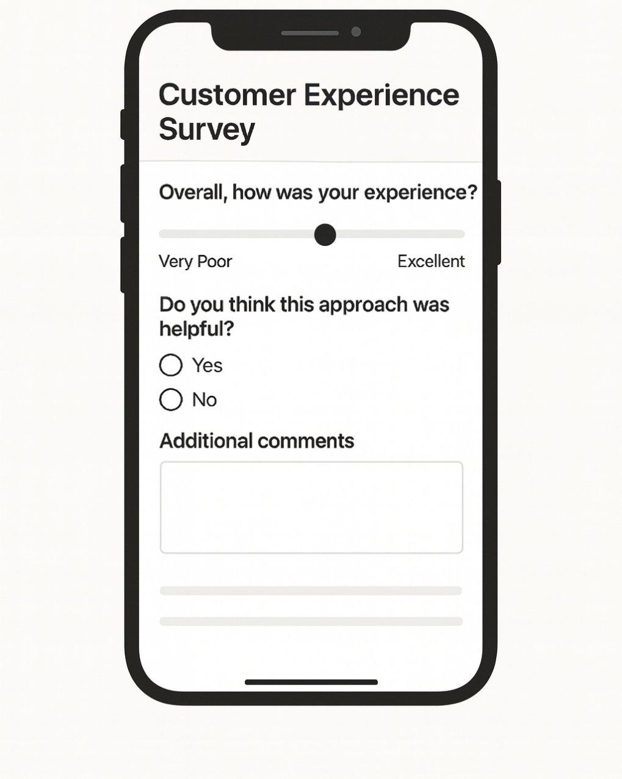
Survey for Customer Feedback

Slide 10
Story Board
Zainab dia
Mohammad iskandarani

